Slide 1
Exponential Smoothing
Joseph Elikishvili IS624 HA7

Slide 2
Quick Review of HA6
Time Series Patterns
Time Series Decomposition
Seasonally adjusted Data
Moving Averages

Slide 3
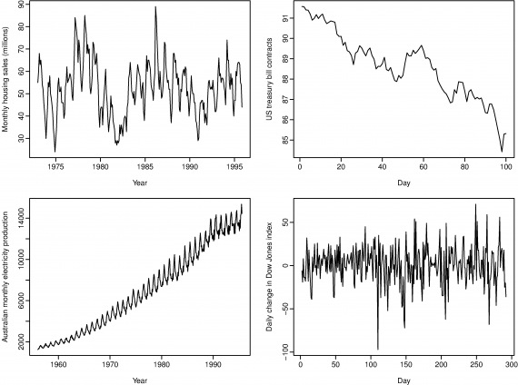
Time Series Patterns
Trend
Seasonal
Cyclic

Slide 4
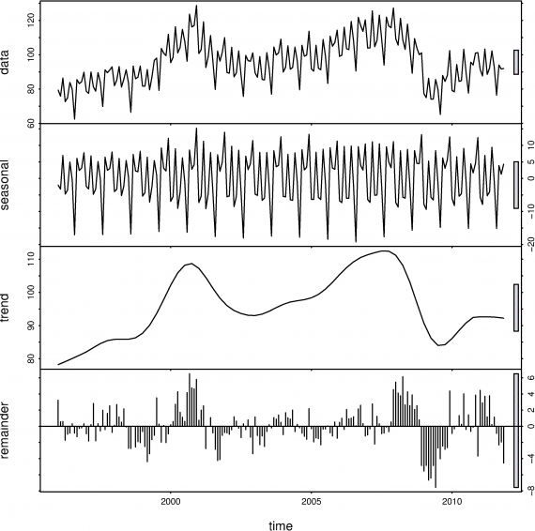
Time series decomposition

Slide 5
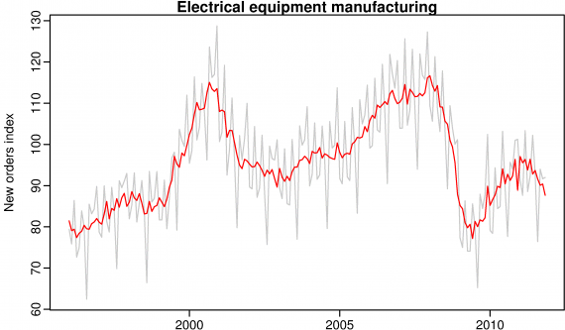
Seasonally adjusted data

Slide 6
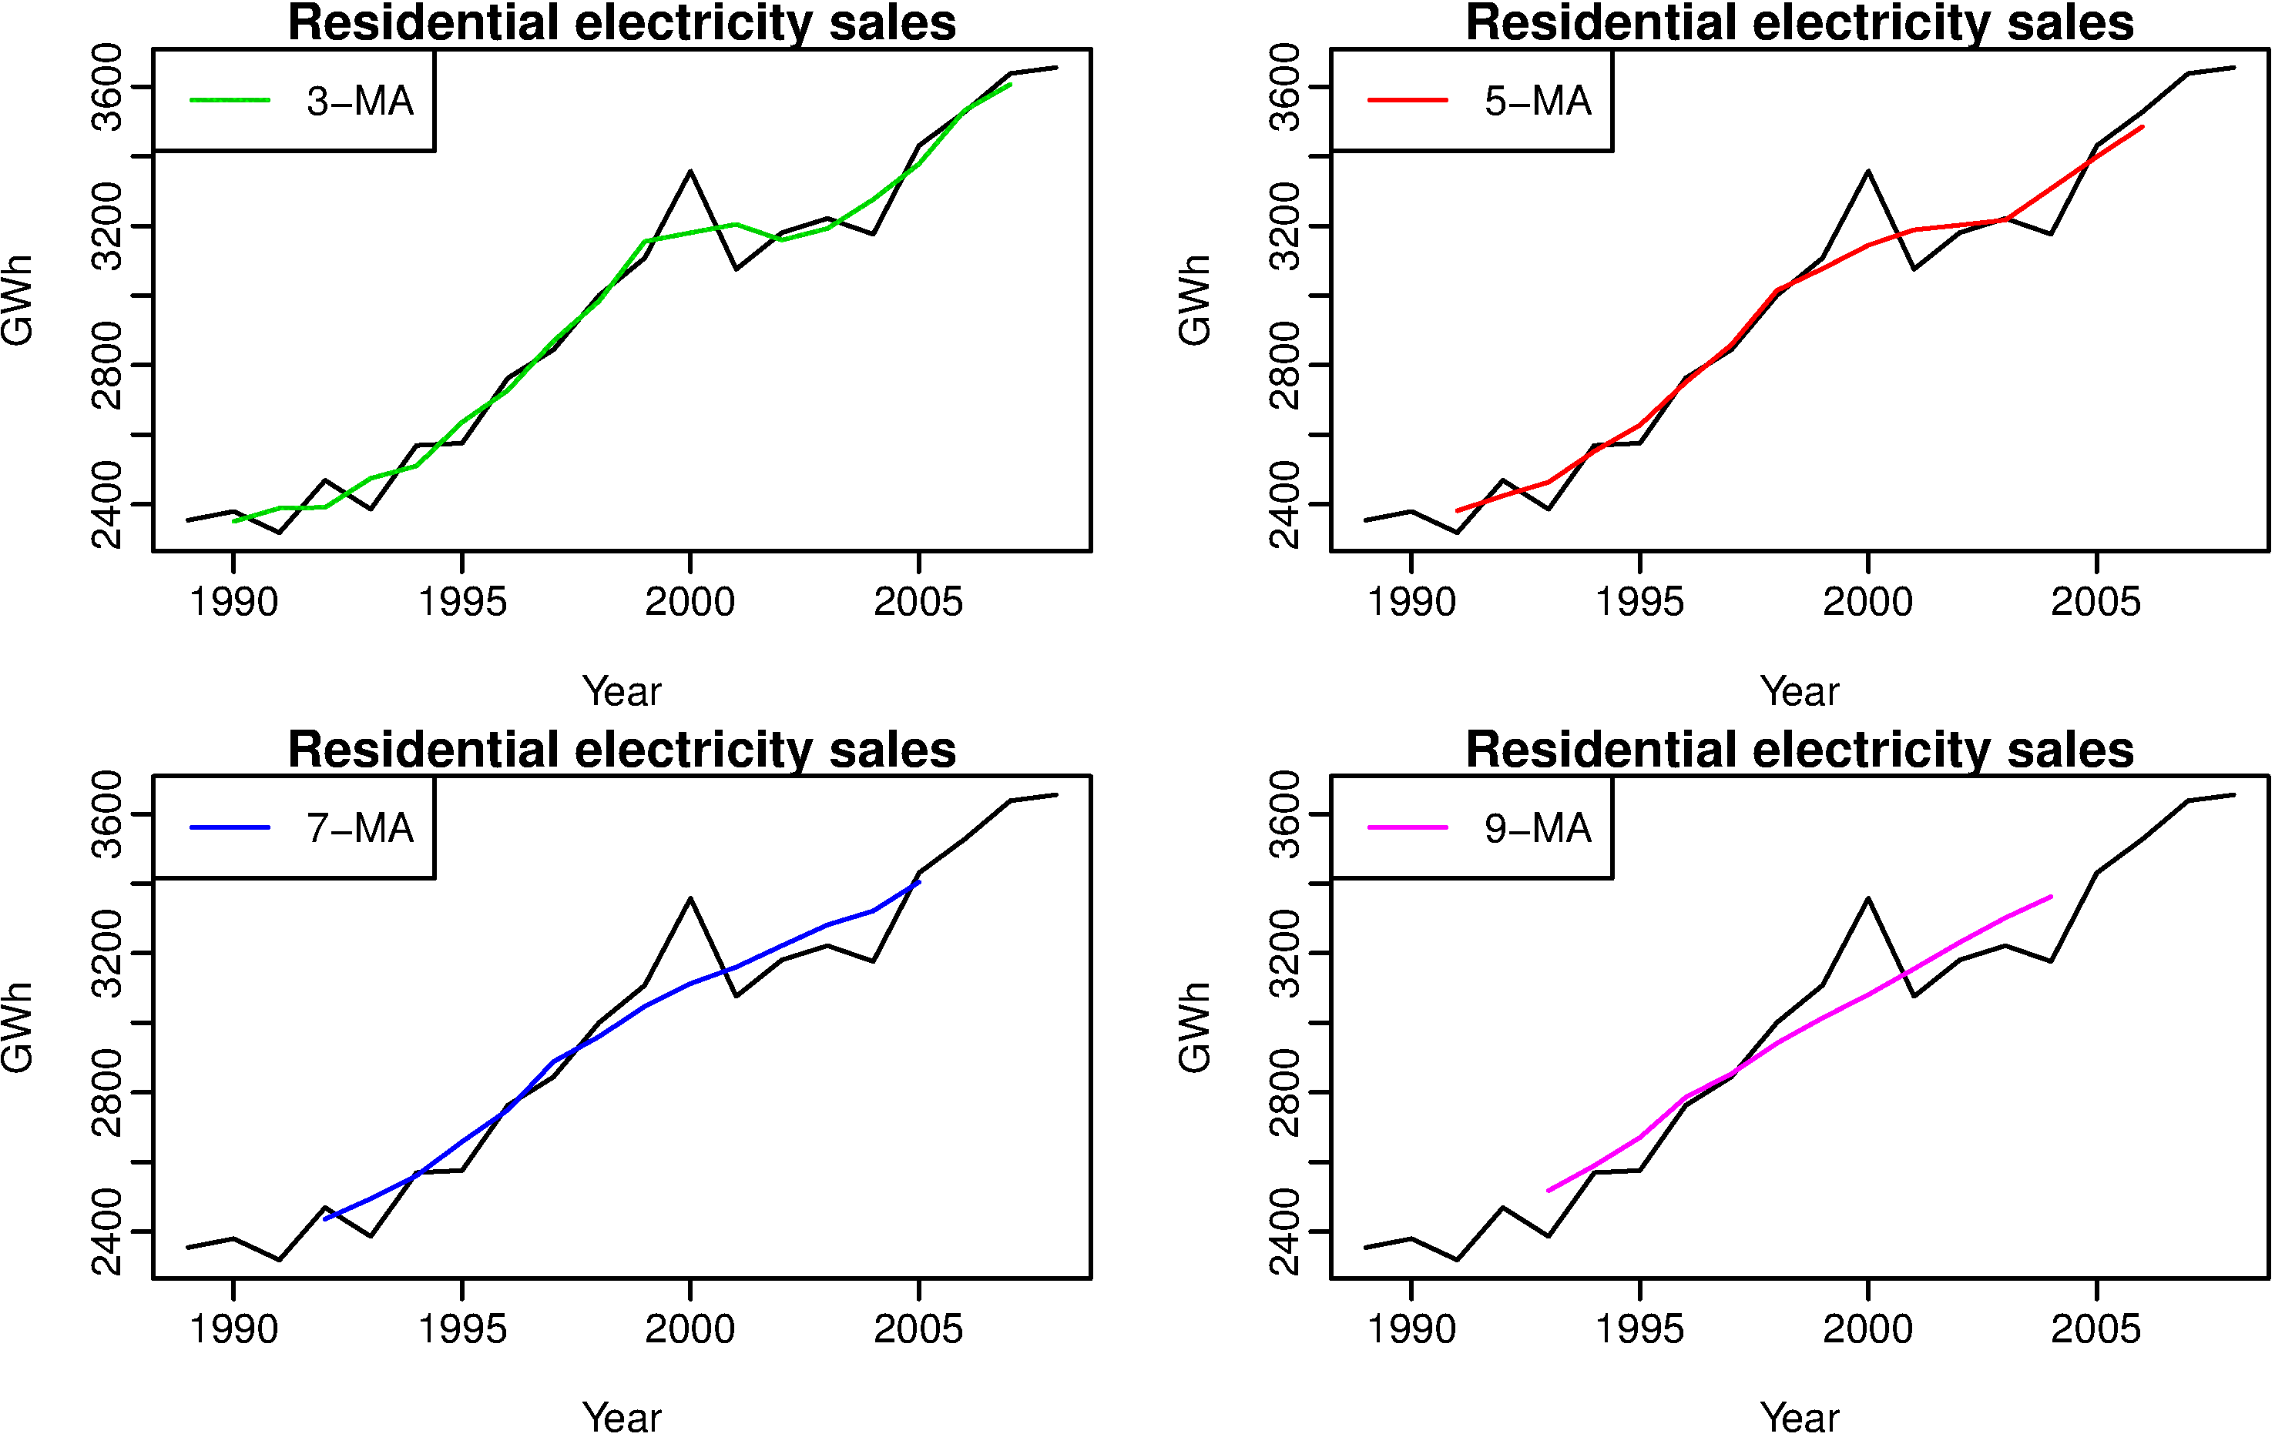
Moving Average

Slide 7



Simple Exponential Smoothing
Naive method
2 5 7 9 9 9
Moving Average
2 5 7 9 9 6.4
Weighted Average
Where alpha is a smoothing parameter 0 ≤ α ≤ 1

Slide 8


Optimization
We estimate the smoothing parameter by minimizing the sum of squared errors (SSE)
We leave alpha out to optimize alpha with ses()

Slide 9

Holt's linear trend method
Holt’s linear trend method extends SES to allow forecasting of data with a trend.

Slide 10
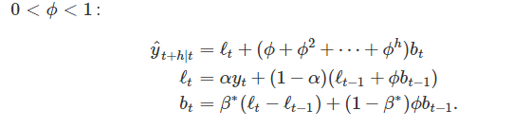
Additive damped trend method
Empirical evidence indicates that these methods tend to over-forecast, especially for longer forecast horizons.

Slide 11
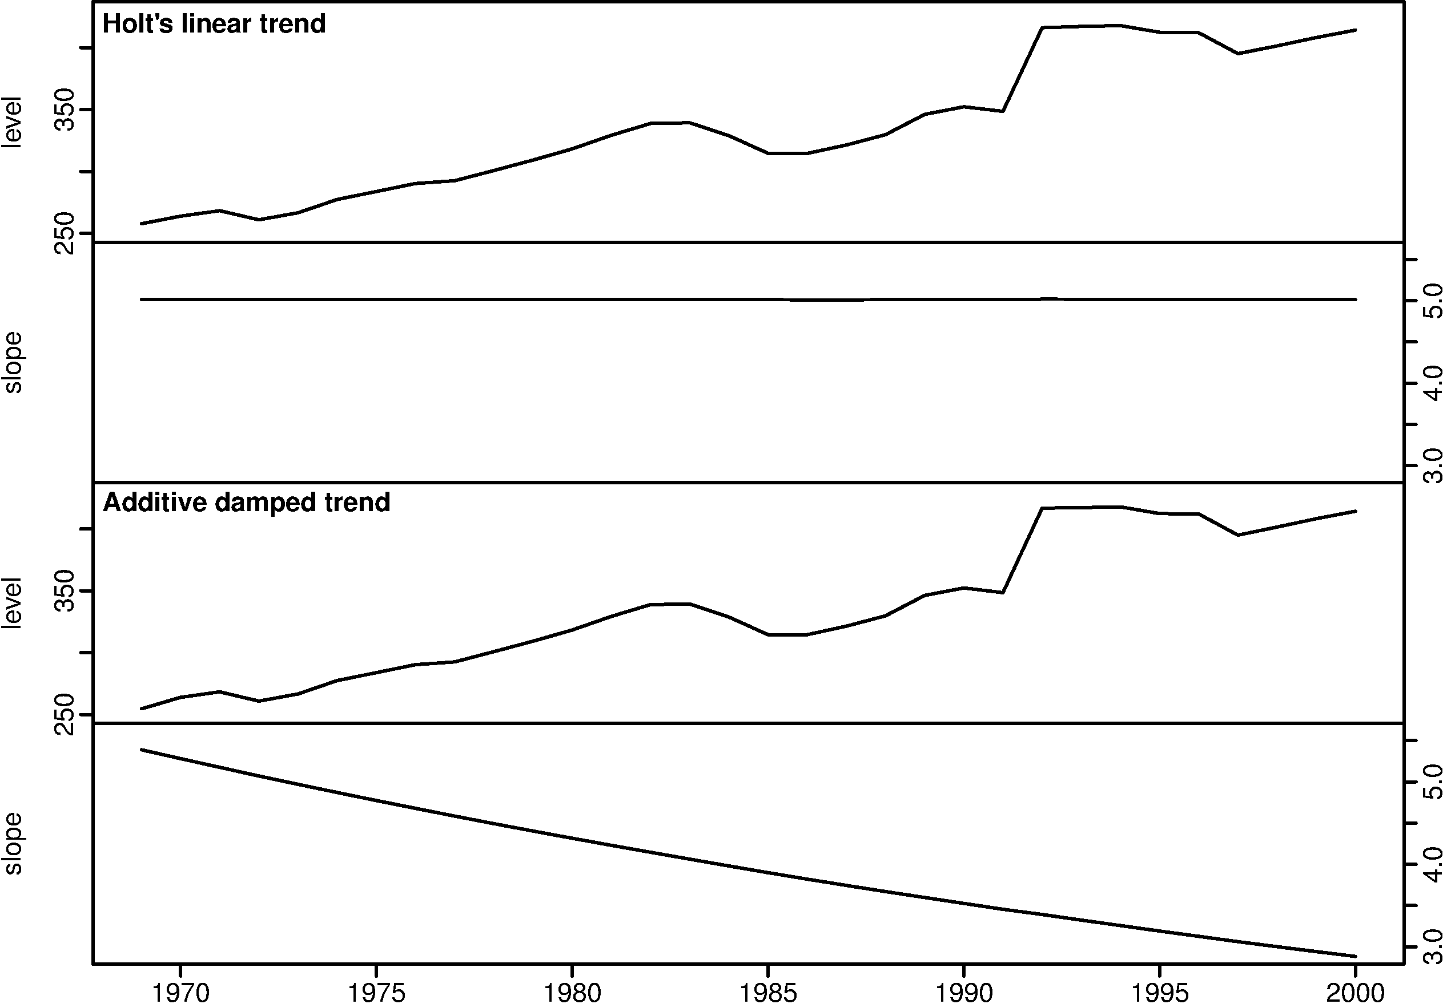
Adaptive trend method effect

Slide 12
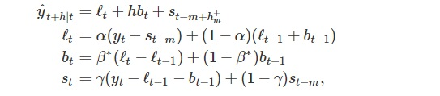
Holt-Winters seasonal method
Holt (1957) and Winters (1960) extended Holt’s method to capture seasonality. The Holt-Winters seasonal method comprises the forecast equation and three smoothing equations
We use m to denote the period of the seasonality, i.e., the number of seasons in a year. For example, for quarterly data m=4, and for monthly data m=12, daily m=7

Slide 13
Holt-Winters seasonal method
The additive method is preferred when the seasonal variations are roughly constant through the series
The multiplicative method is preferred when the seasonal variations are changing proportional to the level of the series

Slide 14
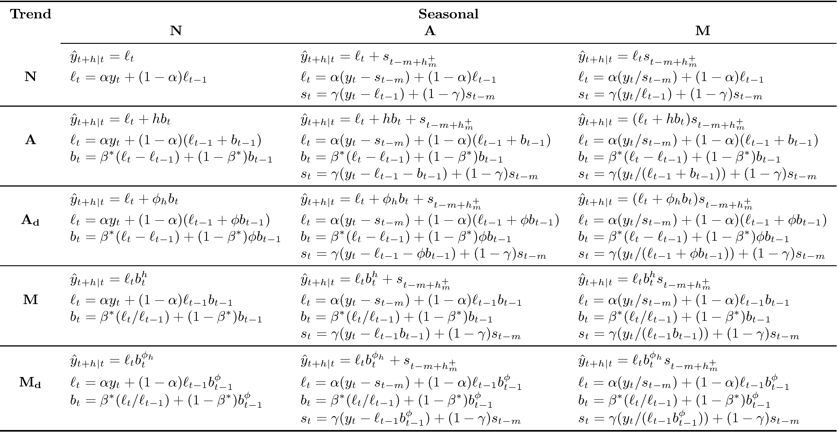
Method Lineup

Slide 15
Innovations state space models
Innovations state space models generate the same point forecasts, but can also generate prediction (or forecast) intervals
Each model consists of a measurement equation that describes the observed data and some transition equations that describe how the unobserved components or states (level, trend, seasonal) change over time. Hence these are referred to as “state space models”.

Slide 16



Additive and Multiplicative errors
ETS(A,N,N): simple exponential smoothing with additive errors
ε∼NID(0,σ^2) NID stands for “normally and independently distributed
ETS(M,N,N): simple exponential smoothing with multiplicative errors

Slide 17
ETS Notation (A,N,N)
Error={A,M}
Trend ={N,A,A_{d},M,M_{d}}
Seasonal = {N,A,M}

Slide 18
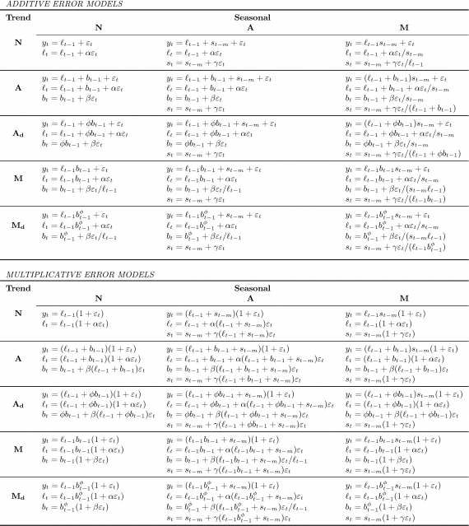
Innovations state space models

Slide 19
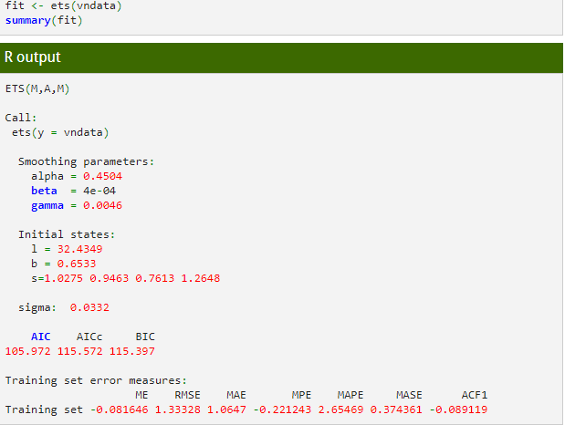
The ets() function in R

Slide 20
Thank you
References: https://www.otexts.org/fpp/7

